Slide 1

TechPilot: An AI-Guided Personalized Learning and Career Readiness Platform for Technology
GUIDED BY:
Dr.A.Manikandan , Associate professor,Department of AIML SCHOOL OF ENGINEERING
VISTAS
PREPARED BY:
Mohammed Afaf Samar - 24619218
Sabarivasan U - 24619223
Manikandan S - 24619261
DATE : 30-10-2026
CLASS AND SEC: B.TECH CSE AIML- B

Slide 2
INTRODUCTION :
A guided path from learning technology skills to career preparation
The Challenge
Students often face scattered learning resources, unclear skill priorities, and uncertainty about career direction
The Idea
TechPilot organizes technology learning, assessments, progress review, and career guidance in one flow
The Goal
Help learners follow a structured roadmap and connect learning activities with practical skill development
plan technology track
Web Development
App Development
AI / ML
Data Science
IoT
Data Science

Slide 3
ABSTRACT
In today's competitive job market, many students and aspiring developers struggle to find a structured path to learn technology skills and secure suitable employment. This project presents TechPilot, an intelligent career guidance application that bridges the gap between self-learning and career readiness in the technology domain. The application offers curated learning tracks across multiple in-demand domains, including Web Development covering HTML, JavaScript, React, and Projects; Machine Learning covering Python, Statistics, core ML concepts, and Projects; UI/UX Design covering design principles, Figma, UX research, and Portfolio building; Cybersecurity covering Networking, Linux, Security, and Projects; and Data Science covering Python, SQL, Statistics, and Projects. Based on the user's performance, interests, and periodic skill-assessment results, the system recommends the most suitable career path and highlights matching job openings or internship opportunities, along with resume-building guidance, interview preparation resources, and progress-tracking dashboards. By integrating structured learning modules with data-driven career recommendations, TechPilot removes the need for learners to depend on scattered resources and generic advice. The system was implemented using a client-server architecture with a responsive front-end and a backend database storing user progress, skill levels, and job-matching data. Testing with sample users showed that the guided learning approach improved skill retention and helped users identify clearer career goals compared to unstructured self-learning. This project demonstrates how combining career counselling with skill development across multiple technology domains can create an effective, accessible pathway for students to learn in-demand skills and achieve employment in the technology industry.
Key words: Career Guidance, Machine Learning, UI/UX Design, Job Recommendation, Skill Assessment

Slide 4
Literature Review
1. AI-Based Personalized E-Learning Systems (2022)
Existing research explains how Artificial Intelligence can personalize learning materials based on students’ knowledge levels and learning preferences. However, providing a complete learning and career guidance solution remains a challenge. <Link url="https://ieeexplore.ieee.org/document/9840390/" title="Source"/>
2. AI-Based E-Learning Recommender Systems (2023)
Research highlights how AI-based recommendation systems suggest suitable learning resources according to students’ interests, learning behaviour, and abilities. Selecting the most relevant content remains an important challenge. <Link url="https://doi.org/10.1016/j.procs.2023.09.061" title="Source"/>
3. Personalized Learning Recommendation in E-Learning (2024)
This study reviews personalized learning recommendation methods and explains how they help students choose appropriate courses and learning materials. It also identifies challenges in providing effective recommendations. <Link url="https://doi.org/10.1109/ACCESS.2024.3428419" title="Source"/>
Research Gap:
Existing systems often focus on learning resources or recommendations separately. TechPilot aims to integrate skill development, assessments, progress tracking, personalized career roadmaps, and job or internship guidance into a single platform.

Slide 5
BASE PAPER
Paper Title: Integrating A Career Preparedness Module into CS2 Curricula Through The Teaching C++ and Java Side-by-Side
Authors: Ryan Rybarczyk and Lingma Acheson
The Core Problem Fragmented Learning: Languages taught sequentially lead to syntax confusion. Missing Rationale: Students lack understanding of Why/When to choose a language. Late Career Guidance: Career prep usually isolated to senior year.
Proposed Methodology
Side-by-Side Teaching: Simultaneous C++ (Red) & Java (Blue) syntax comparison Career Module Embedded: Real-world language trade-off analysis in CS2. Peer-Led Learning: PLTL lab structure using private GitHub workflow
Empirical Results
4% Failure Rate Drop: Reduced CS2 course failure rate compared to prior terms.
90% Satisfaction: Overwhelming student satisfaction with side-by-side format
Deeper Understanding: Shifted focus from syntax bugs to core CS concepts.

Slide 6
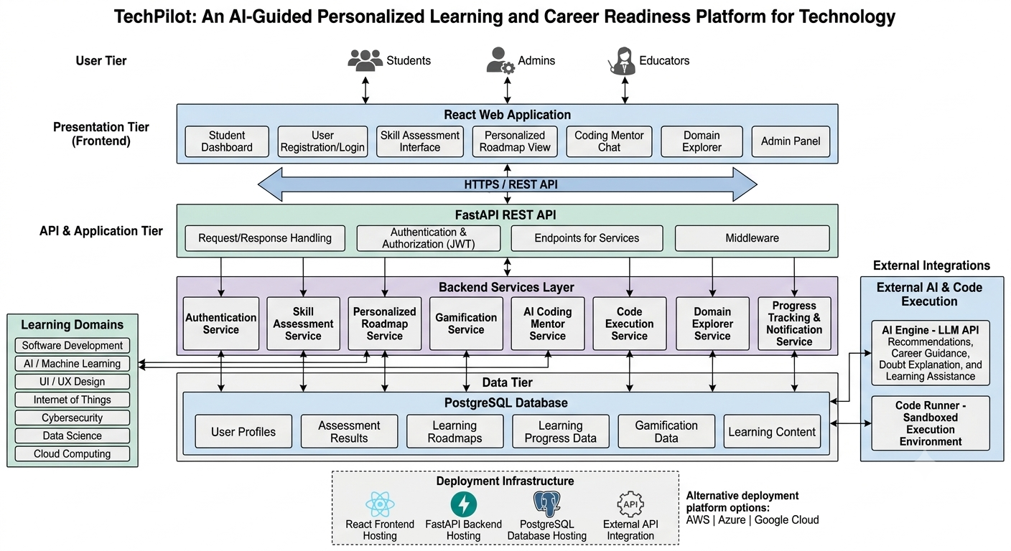

Slide 7
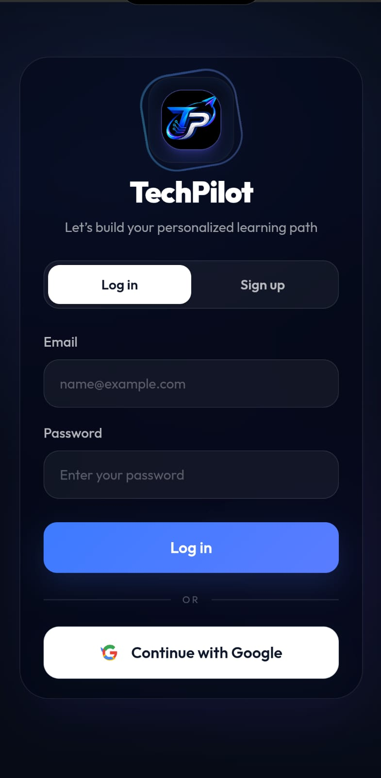
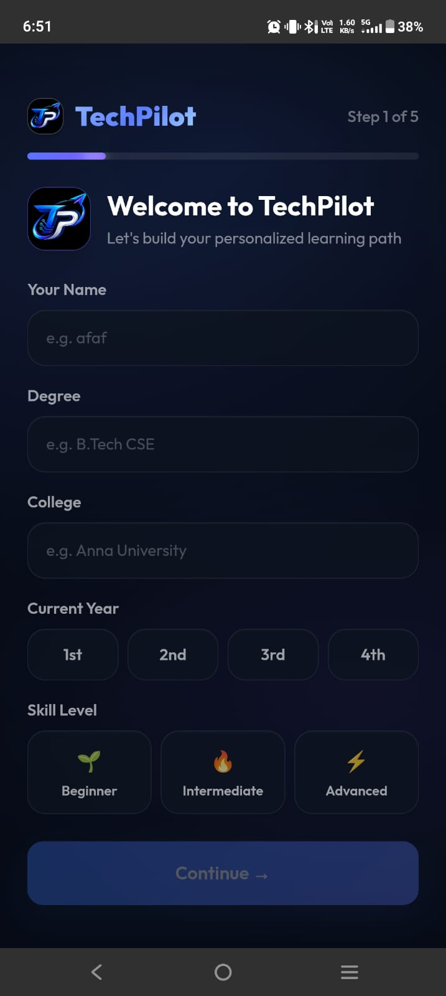
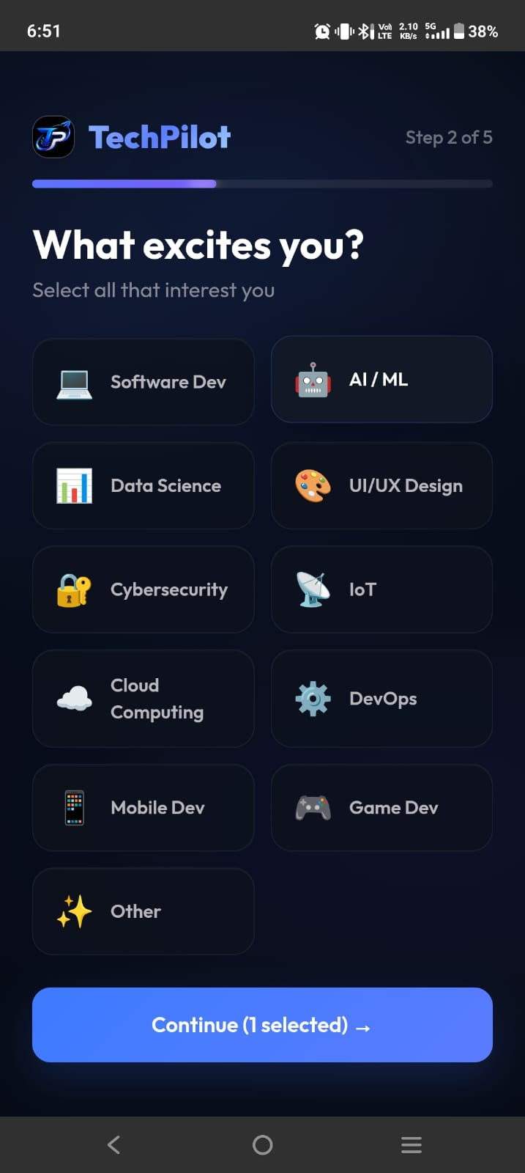
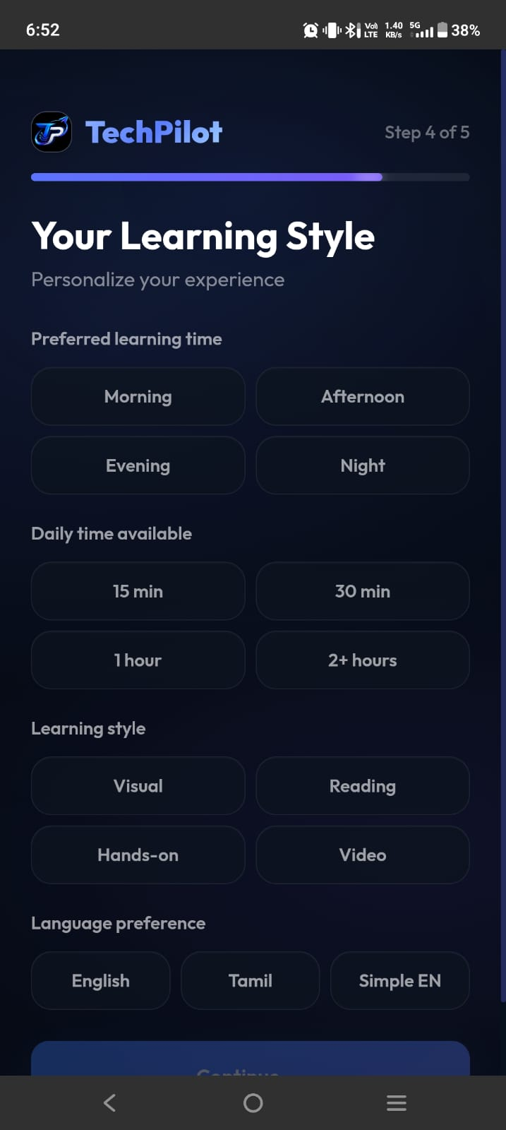
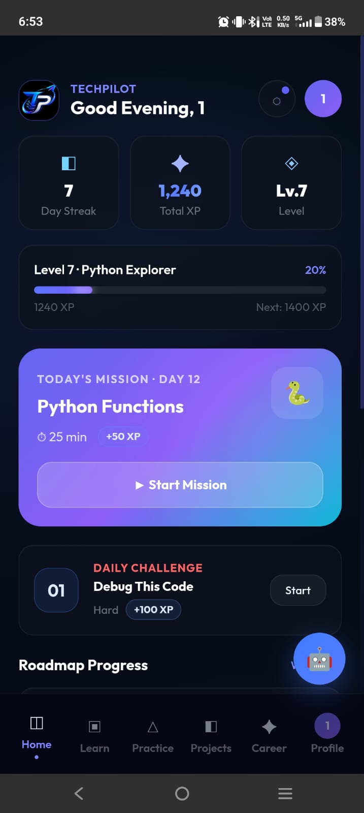
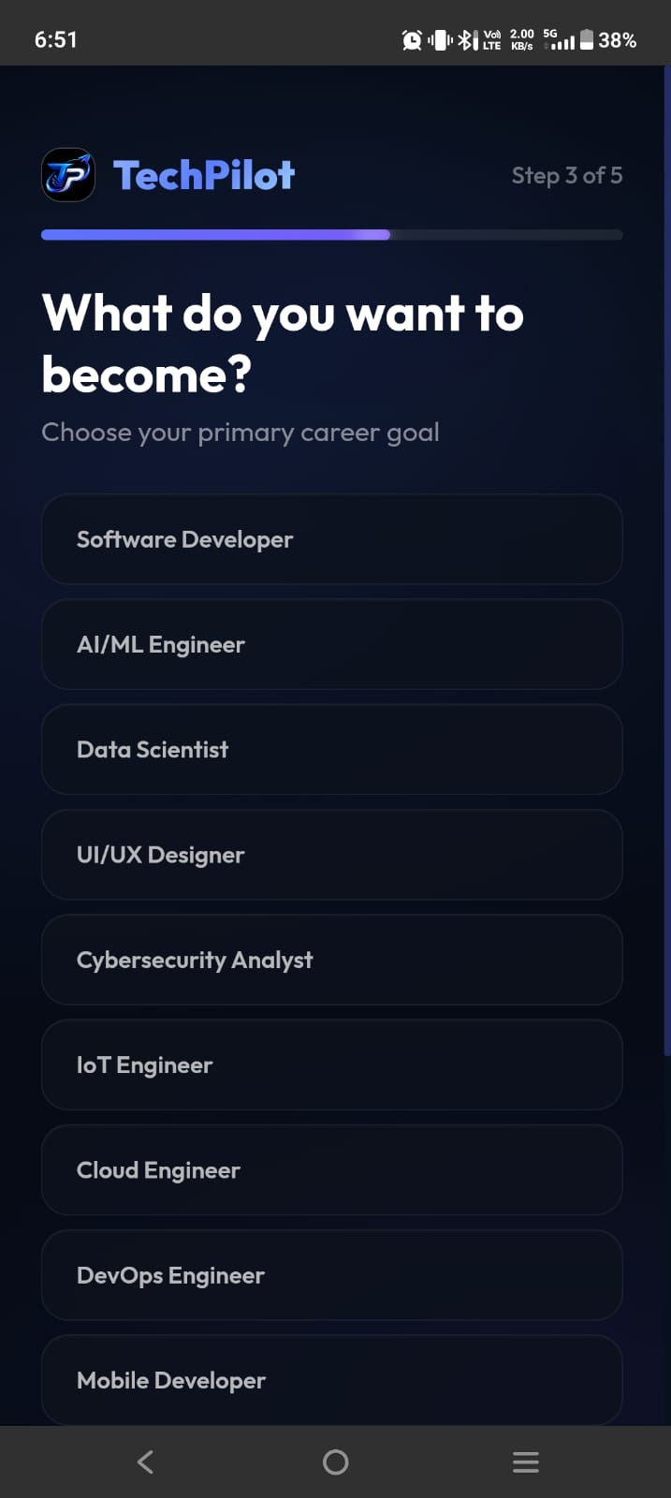

Slide 8
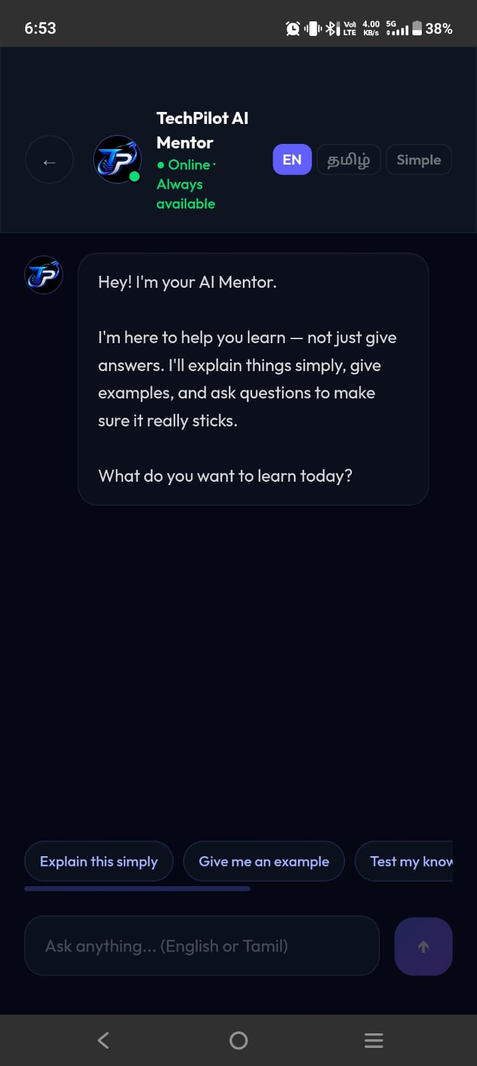
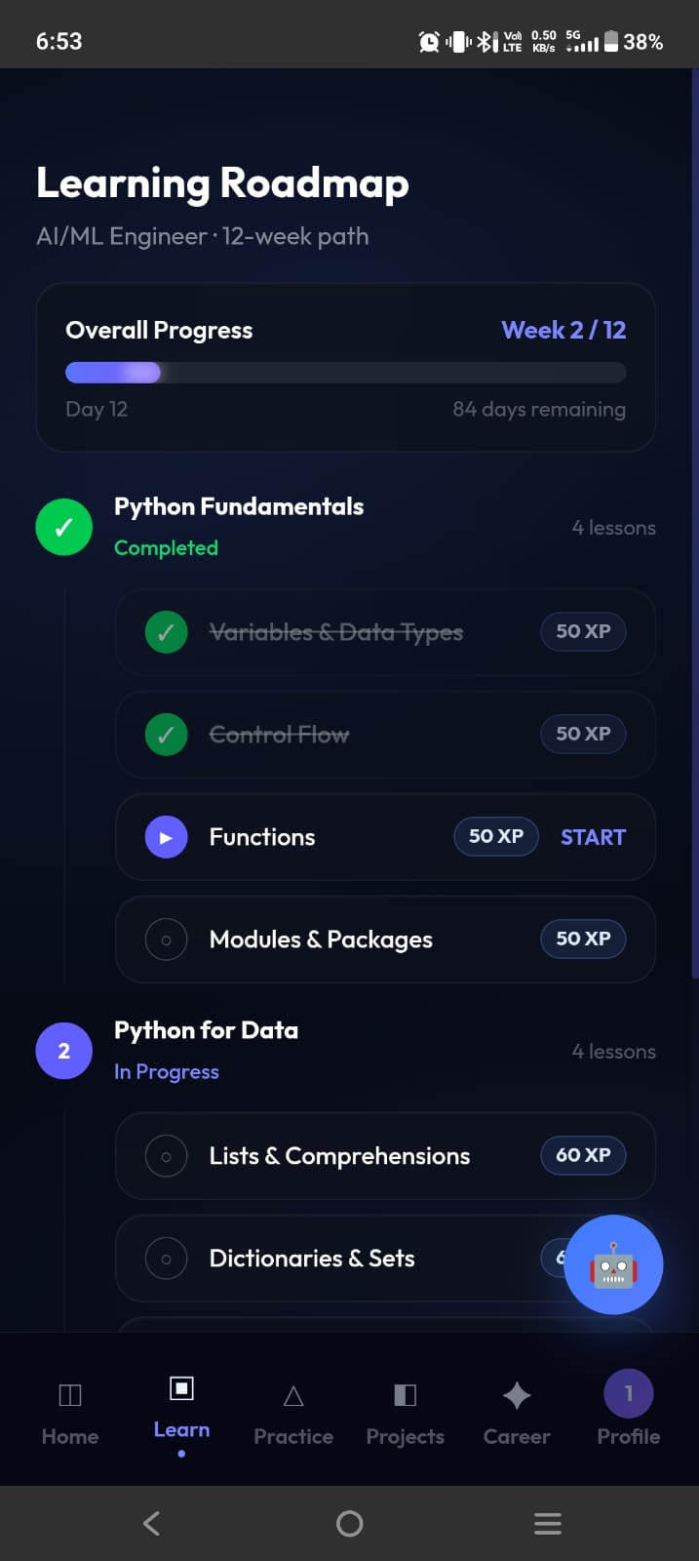
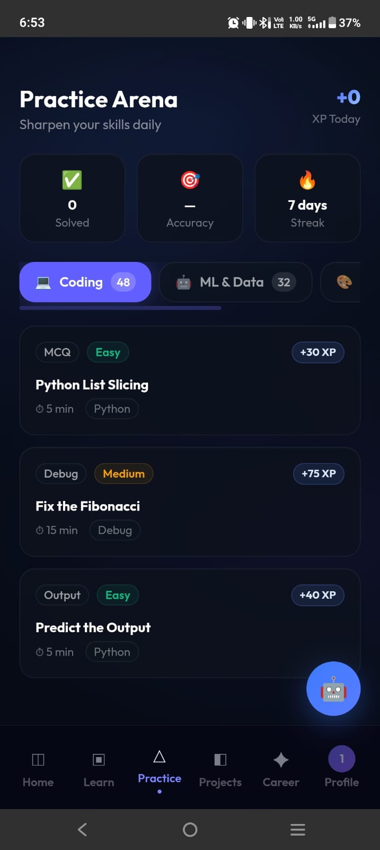
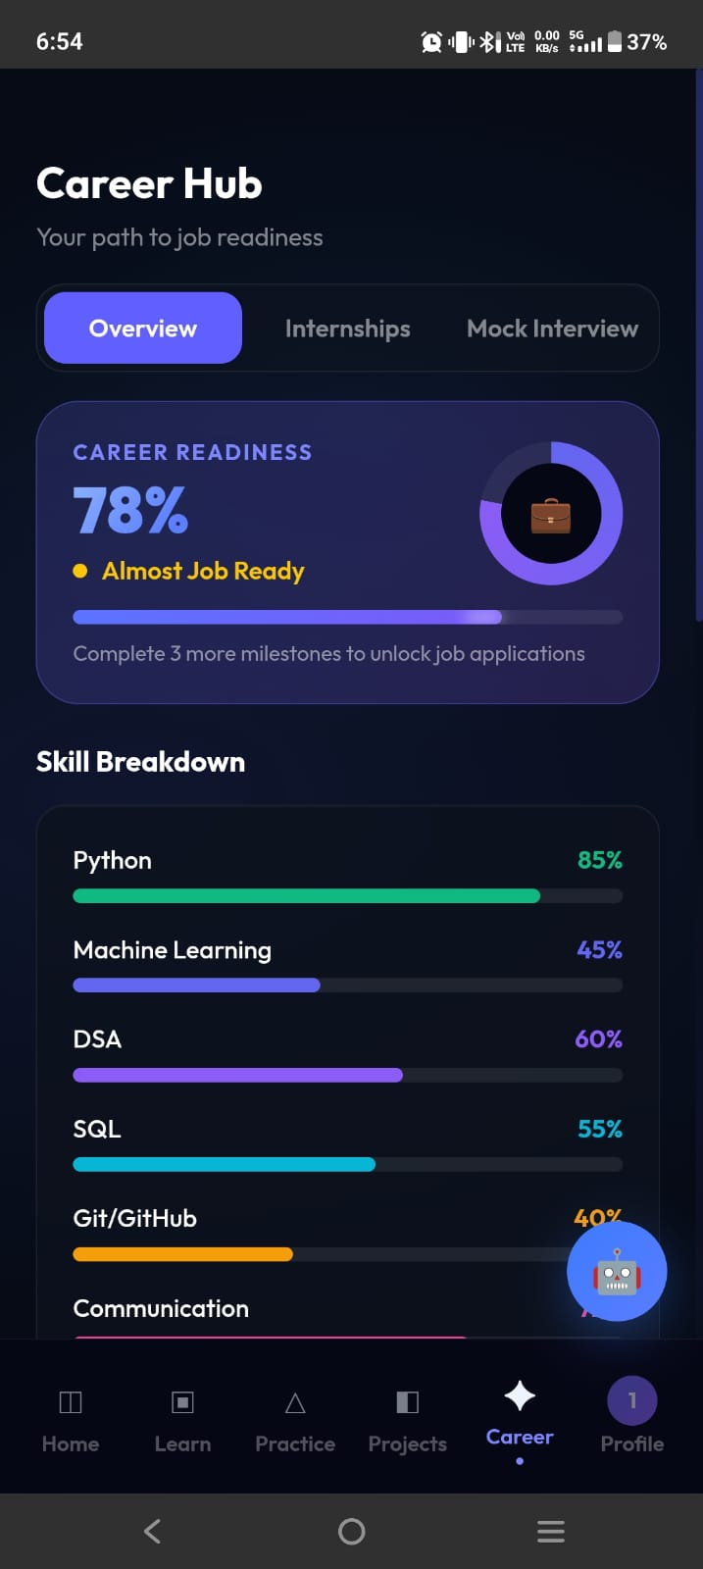
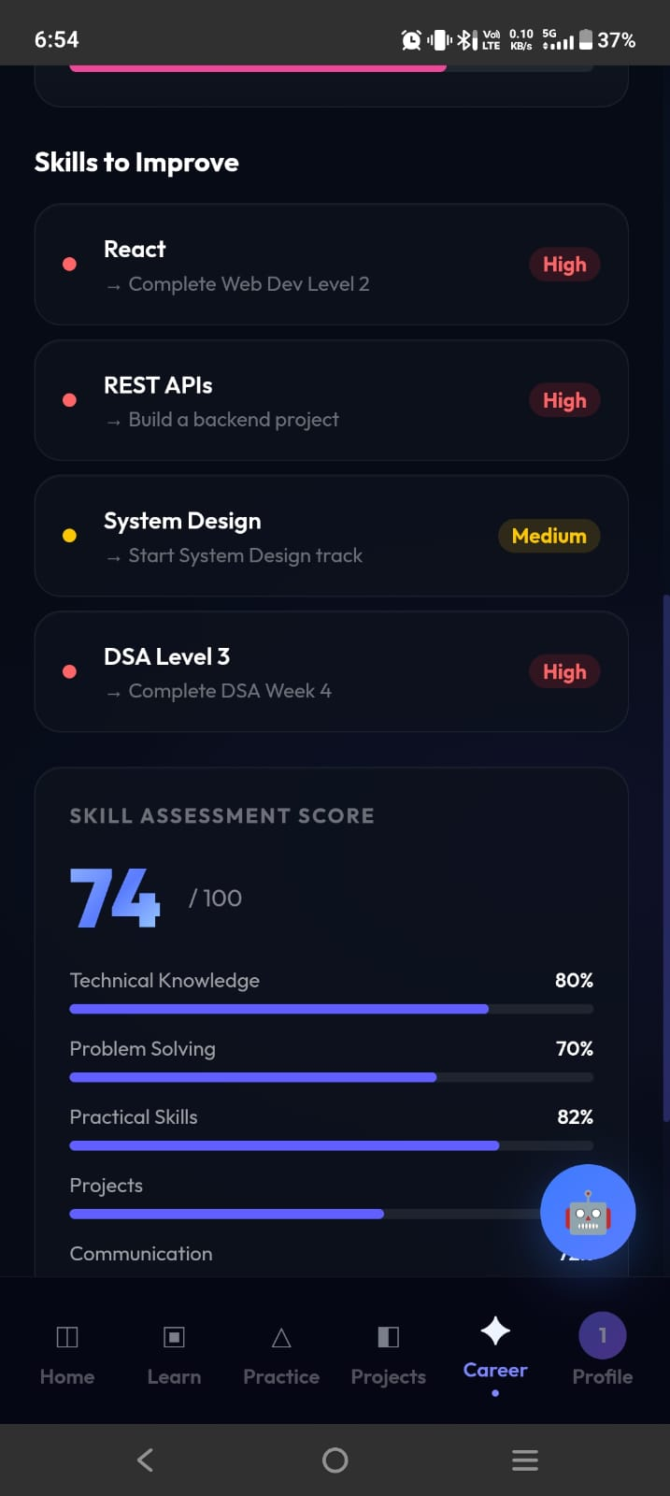
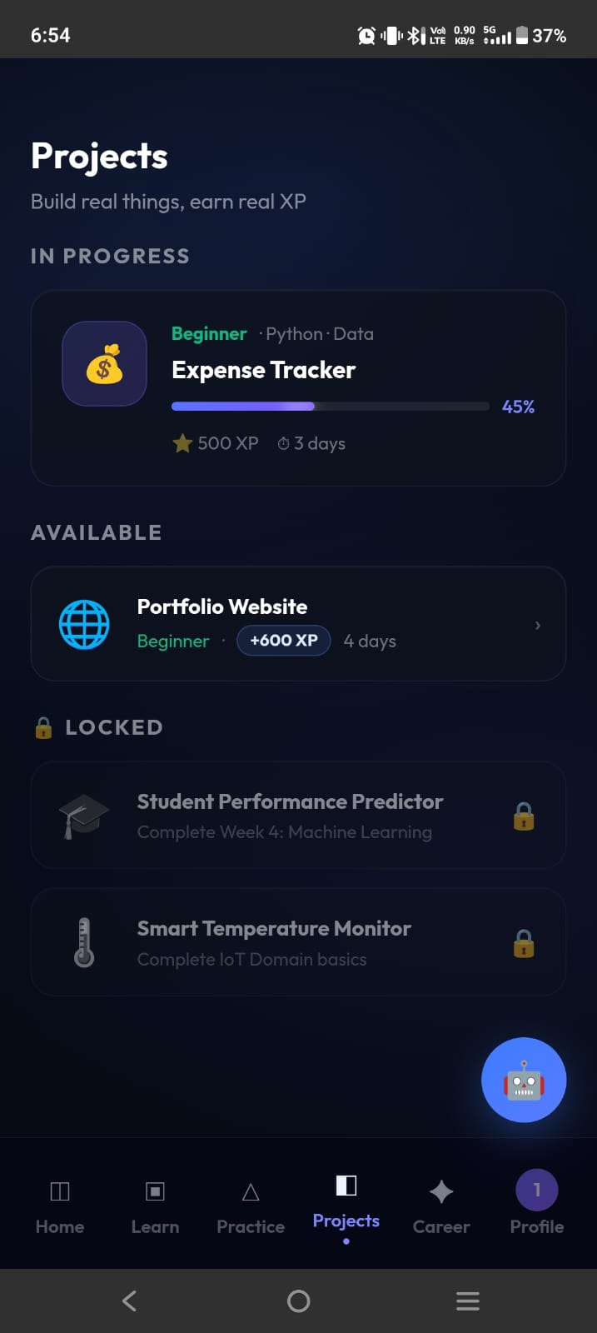

Slide 9
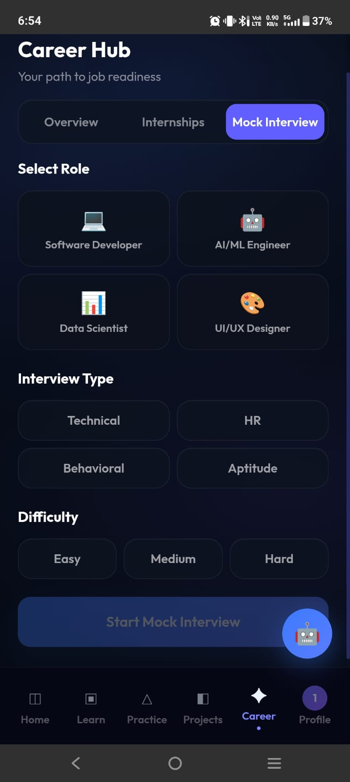
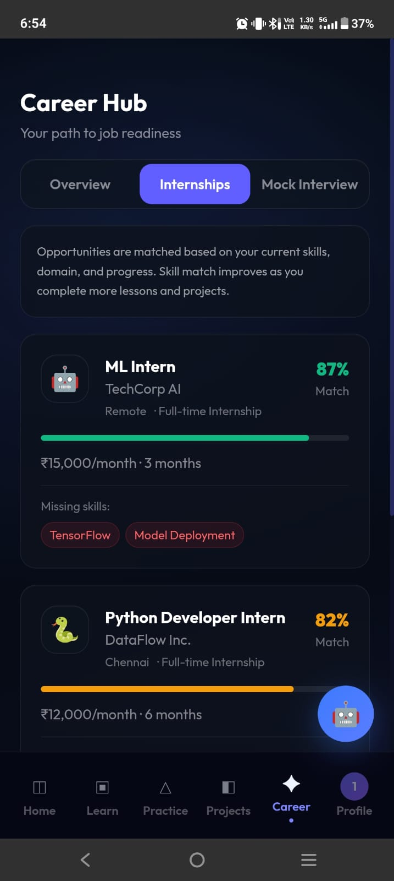
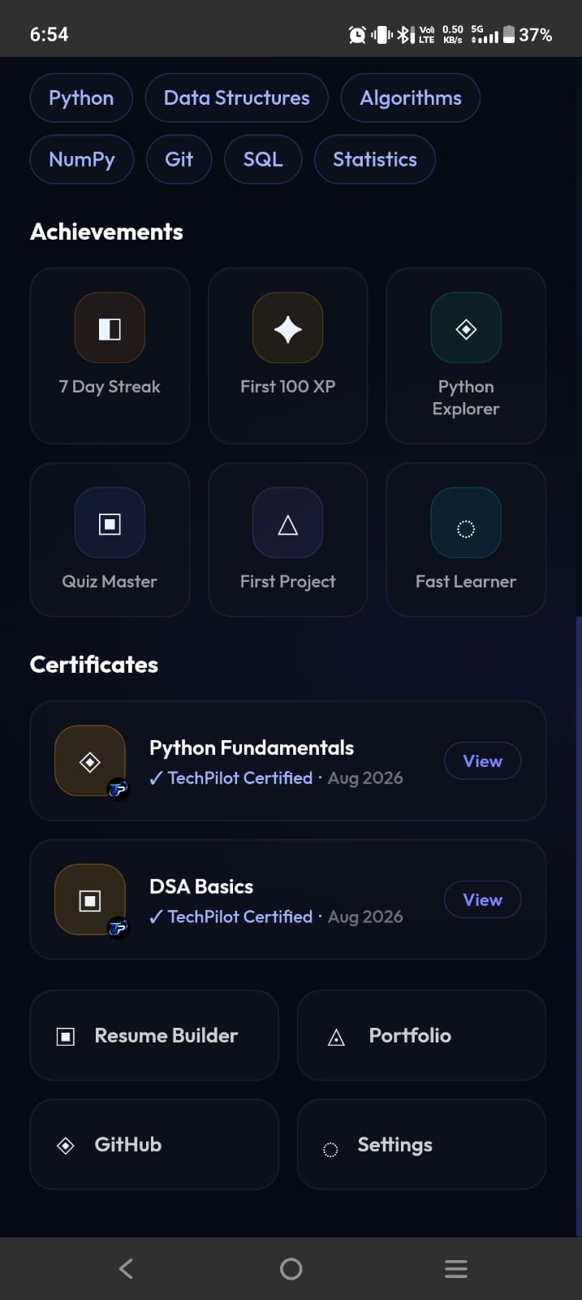

Slide 10
RESULT
The TechPilot platform provides a structured and interactive learning environment for students.
Students can select their preferred technology courses and follow a step-by-step learning roadmap.
Quizzes and coding tasks help students assess their knowledge and monitor their learning progress.
AI-based doubt assistance supports students in understanding technical concepts more easily.
Career guidance, resume preparation, and interview practice help students prepare for future job opportunities.
Outcome: TechPilot aims to improve students’ technical skills, learning experience, and career readiness through personalized and structured learning.

Slide 11
REFERENCE
N. S. Raj, “A Systematic Literature Review on Adaptive Content Recommenders in Personalized Learning Environments,” Technology, Knowledge and Learning, 2022.
X. Wang et al., “The Efficacy of Artificial Intelligence-Enabled Adaptive Learning Systems,” Journal of Educational Computing Research, 2024.
E. du Plooy et al., “Personalized Adaptive Learning in Higher Education: A Scoping Review,” Heliyon, 2024.
IEEE Research Papers on AI-Based Personalized E-Learning Systems, 2022.
Official documentation: React.js, https://react.dev/
Official documentation: Python, https://www.python.org/

Slide 12
THANKYOU !
ANY QUESTIONS

